Slide 1
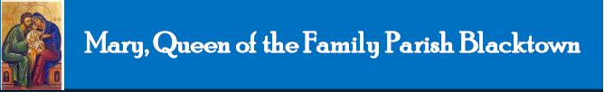
Mary, Queen of the Family Parish
is a welcoming, diverse, multicultural, Catholic community.
We seek to live, teach and share the joy of the Gospel;
to grow as disciples of Jesus through prayer, witness and action
and to respond to the needs of the family in the Blacktown community and beyond.
Notes:
Saturday 5.30PM First Sunday of Advent
16th Sunday in Ord Time Year B

Slide 2
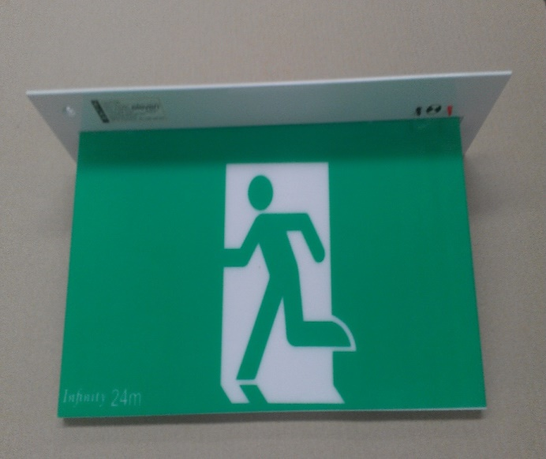
SAFETY MESSAGE
Please take a moment to
identify your closest exit.
There will be an announcement if we need to evacuate the building.
Evacuate the building via the nearest Exit & proceed directly to the footpath along Orwell Street.
DO NOT move any vehicles or remain in the car park.

Slide 3
Welcome to our Parish …
Holy Family
You have entered a SACRED SPACE ... A SACRED TIME…
Please ensure all mobile phones are switched off.
Please be respectfully quiet as we prepare for our Celebration.
Notes:
Saturday 5.30PM First Sunday of Advent
16th Sunday in Ord Time Year B

Slide 4
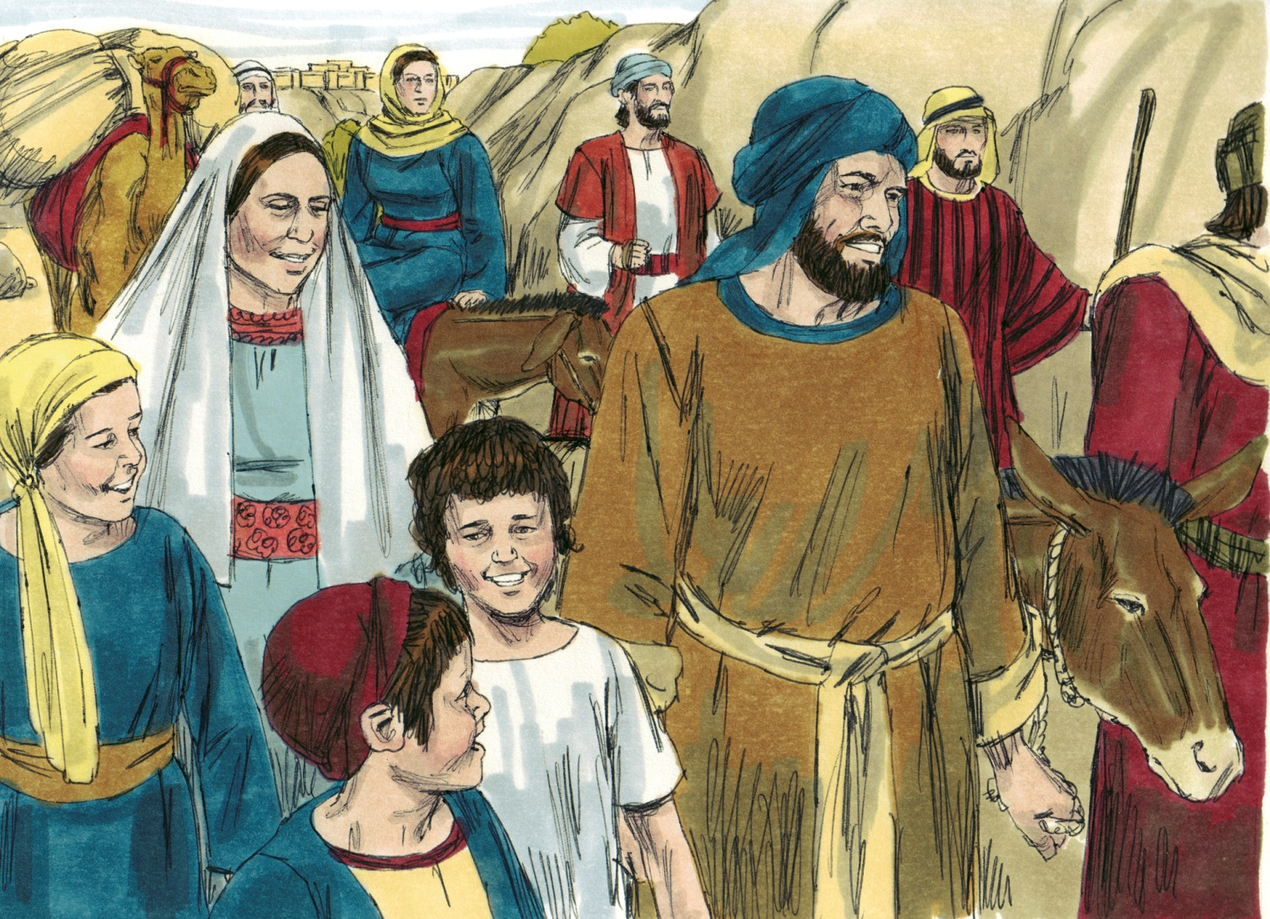
Every year the parents of Jesus used to go to Jerusalem for the feast of the Passover.
Notes:
16th Sunday in Ord Time Year B

Slide 5
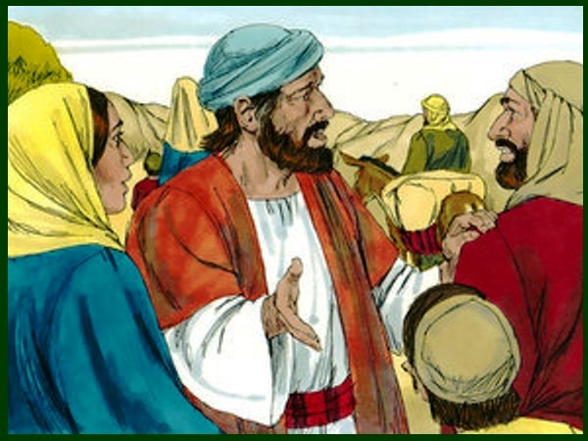
…the boy Jesus stayed behind in Jerusalem without his parents knowing it …
Notes:
16th Sunday in Ord Time Year B

Slide 6
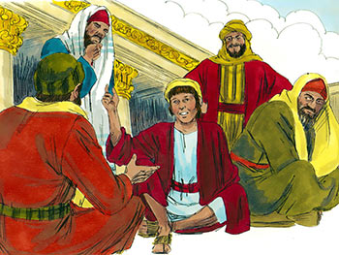
Three days later, they found him in the Temple, sitting among the doctors, listening to them, and asking them questions…
Notes:
16th Sunday in Ord Time Year B

Slide 8
PLEASE STAND

Slide 9
ENTRANCE ANTIPHON
The shepherds went in haste,
and found Mary and Joseph and the Infant lying in a manger.
The English translation of The Roman Missal © 2010,
International Commission on English in the Liturgy Corporation. All rights reserved.

Slide 11
Penitential Act
Lord have mercy. Lord have mercy.
Christ have mercy. Christ have mercy.
Lord have mercy. Lord have mercy.
The English translation of The Roman Missal © 2010,
International Commission on English in the Liturgy Corporation. All rights reserved.

Slide 13
GLORIA
Glory to God in the highest,
and on earth peace to people of good will.
We praise you, we bless you,
we adore you, we glorify you,
we give you thanks for your great glory,
Lord God, heavenly King,
O God, almighty Father.

Slide 14
Lord Jesus Christ, Only Begotten Son,
Lord God, Lamb of God, Son of the Father,
you take away the sins of the world,
have mercy on us;
you take away the sins of the world,
receive our prayer;
you are seated at the right hand of the Father, have mercy on us.

Slide 15
For you alone are the Holy One,
you alone are the Lord,
you alone are the Most High, Jesus Christ, with the Holy Spirit,
in the glory of God the Father.
Amen.
The English translation of The Roman Missal © 2010,
International Commission on English in the Liturgy Corporation. All rights reserved.

Slide 17

Responsorial Psalm
Happy are those who fear the Lord and walk in his ways.

Slide 18
O blessed are those who fear the Lord
and walk in his ways!
By the labour of your hands
you shall eat.
You will be happy and prosper.
Happy are those who fear the Lord and walk in his ways.

Slide 19
Your wife like a fruitful vine
in the heart of your house;
your children like shoots of the olive,
around your table.
Happy are those who fear the Lord and walk in his ways.

Slide 20
Indeed thus shall be blessed
the man who fears the Lord.
May the Lord bless you from Zion
all the days of your life!
Happy are those who fear the Lord and walk in his ways.

Slide 21


Slide 22
Gospel Acclamation
Alleluia, alleluia!
May the peace of Christ rule in our hearts, and the fullness of his message live within you.
Alleluia!

Slide 24
APOSTLES’ CREED
I believe in God,
the Father almighty,
Creator of heaven and earth,
and in Jesus Christ, his only Son, our Lord,
(At the words that follow, up to and including the Virgin Mary, all bow.)
who was conceived by the Holy Spirit,
born of the Virgin Mary,
suffered under Pontius Pilate,
was crucified, died and was buried;
he descended into hell;

Slide 25
on the third day he rose again from the dead;
he ascended into heaven,
and is seated at the right hand
of God the Father almighty;
from there he will come to judge
the living and the dead.
I believe in the Holy Spirit,
the holy catholic Church,
the communion of saints,
the forgiveness of sins,
the resurrection of the body,
and life everlasting. Amen.

Slide 27
First Collection
This collection goes to the Bishop
for the support of the Diocese.
Thank you for your contribution

Slide 29
Holy, Holy, Holy
Holy, Holy, Holy Lord God of hosts,
Heaven and earth are full of your glory.
Hosanna in the highest
Blessed is he who comes
in the name of Lord,
Hosanna in the highest.
The English translation of The Roman Missal © 2010,
International Commission on English in the Liturgy Corporation. All rights reserved.

Slide 31
Save us, Saviour of the world,
for by your Cross
and Resurrection
you have set us free.
Memorial Acclamation
We proclaim your Death, O Lord,
and profess your Resurrection
until you come again.
When we eat this Bread and drink this Cup, we proclaim your Death,
O Lord, until you come again.
The English translation of The Roman Missal © 2010,
International Commission on English in the Liturgy Corporation. All rights reserved.
Notes:
Sunday 10AM First Sunday of Advent
7am - 14th Sunday in Ord Time
16th Sunday in Ord Time Year B

Slide 33
Amen
When we eat this Bread and drink this Cup, we proclaim your Death,
O Lord, until you come again.
Amen
We proclaim your Death, O Lord,
and profess your Resurrection
until you come again.
The English translation of The Roman Missal © 2010,
International Commission on English in the Liturgy Corporation. All rights reserved.
Notes:
Sunday 10AM First Sunday of Advent
7am - 14th Sunday in Ord Time
16th Sunday in Ord Time Year B

Slide 35
Lamb of God
Lamb of God, you take away the sins of the world, have mercy on us.
Lamb of God, you take away the sins of the world, have mercy on us.
Lamb of God, you take away the sins of the world, grant us peace.
The English translation of The Roman Missal © 2010,
International Commission on English in the Liturgy Corporation. All rights reserved.

Slide 37
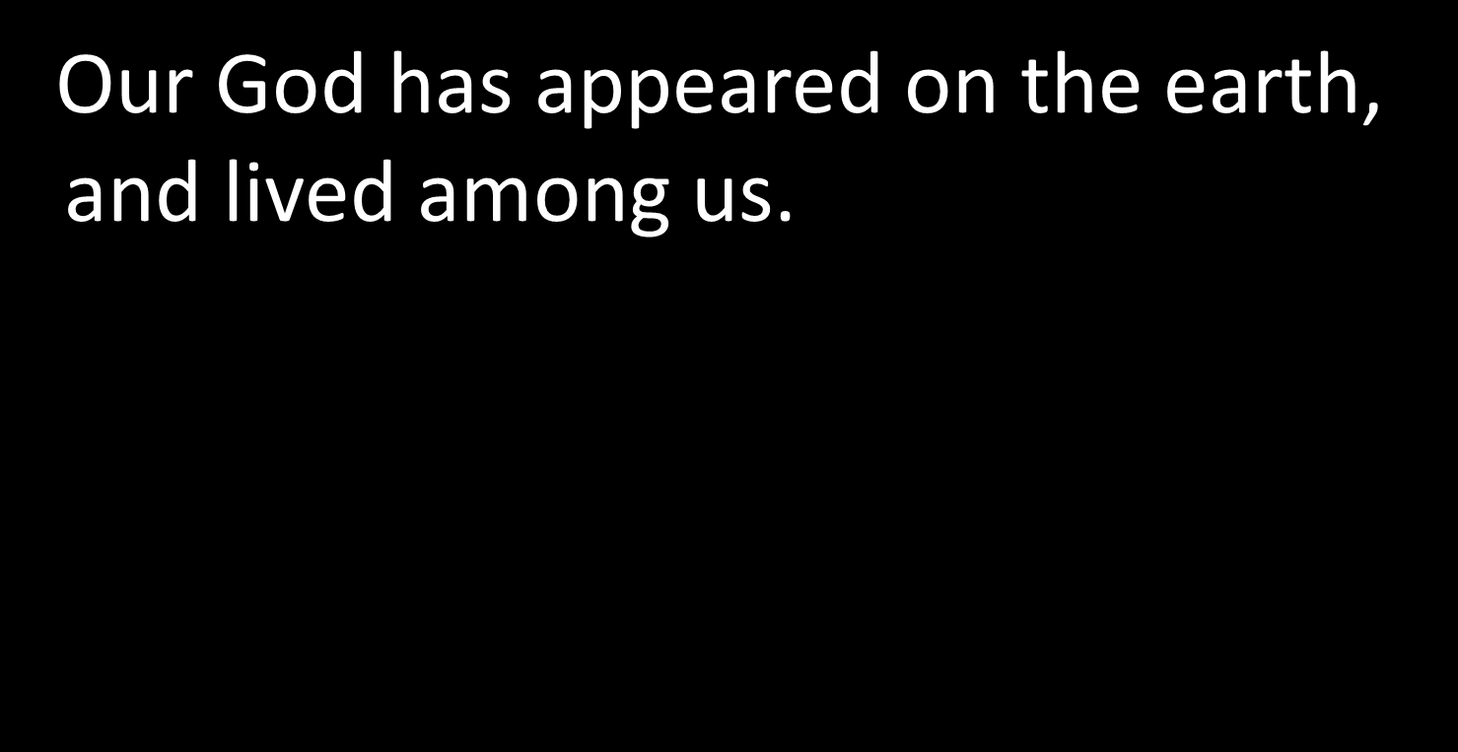
COMMUNION ANTIPHON
The English translation of The Roman Missal © 2010,
International Commission on English in the Liturgy Corporation. All rights reserved.

Slide 39
Second Collection
What you contribute now
is for the support of our
parish and its mission.
Thank you for your generosity

Slide 40
PARISH OFFICE CLOSED UNTIL MONDAY 4 JANUARY
USE AFTERHOURS NUMBER TO CONTACT PRIEST

Slide 41
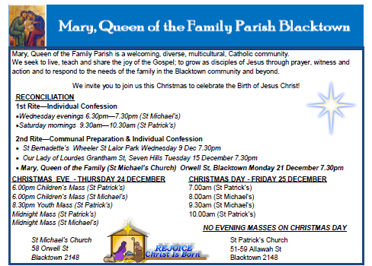



www.mqofblacktown.org.au
    www.facebook.com/blacktowncatholics
@mqofblacktown

Slide 44
www.mqofblacktown.org.au
    www.facebook.com/blacktowncatholics
@mqofblacktown

